Slide 1

AI-Enabled Regulatory Change Management & Policy Alignment
April 2026

Slide 2
Executive Summary
Why This Matters Now
THE CHALLENGE
IMAG SOLUTION
Regulatory change is accelerating
Manual, fragmented processes
→ Slow, inconsistent, high-risk
Misalignment creates:
Regulatory exposure
Costly remediation cycles
Inefficient operations
Embed AI into existing processes
to deliver:
✓ Continuous alignment
✓ Controlled implementation
✓ Auditable documentation
2

Slide 3
Core Problem
No Systematic Process
Capture regulatory changes globally
Assess applicability across jurisdictions
Translate changes into policy updates
Resulting Risks
Policy gaps and inconsistencies
Delayed implementation
Lack of audit trail and defensibility
Post-Remediation Challenges
Reversion to manual processes
Lack of sustainability
3

Slide 4
Market Reality
What We See Across Clients
📊
🔌
💰
Manual Workflows
Disconnected Systems
High Compliance Costs
Heavy reliance on SMEs + spreadsheets + email workflows
Siloed systems across jurisdictions
Regulatory exams
Internal audit findings
External remediation programs
4

Slide 5
IMAG Approach
Differentiation
We do NOT replace your process — we enhance it
1
Map existing regulatory change workflow end-to-end
2
Insert AI agents at critical control points
3
Maintain SME decision authority at every step
4
Operate fully within client's environment (no external platform dependency)
Key principle: AI recommends — Humans decide
5

Slide 6
How It Works
Process Integration
Regulatory change capture
AI-driven relevance assessment
Policy gap analysis
Recommendation engine
SME validation & approval
Documentation & audit trail
1
2
3
4
5
6
Outcome: Continuous, repeatable regulatory alignment cycle
6

Slide 7
Core Design Principles
Governed Automation
AI operates within defined workflows and controls
Audit Readiness
Explainability by Design
Regulator-ready documentation from day 1
Full traceability to source regulations and decisions
IMAG
Framework
Operational Consistency
Human-in-the-Loop
Standardized outputs across jurisdictions
No autonomous decision-making
7

Slide 8
Technology Strategy
Practical, Not Disruptive
LEVERAGES
OR SUPPORTS
Existing client systems
Existing AI tools (if available)
Vendor selection and implementation
MODULAR AND SCALABLE
Start small (e.g., AML, privacy, licensing)
Expand across enterprise
Critical point: No forced technology replacement or transformation risk
8

Slide 9
Business Impact
IMMEDIATE BENEFITS
STRATEGIC BENEFITS
Faster regulatory response time
Reduced regulatory risk exposure
Lower remediation costs
Reduced manual effort
Stronger centralized oversight and governance
Improved policy consistency
Scalable operating model across jurisdictions
0-6 months
6-18 months
9

Slide 10
Industry Adaptation
Financial Institutions
🏦
FOCUS AREAS
AML / KYC and Sanctions
Regulatory reporting
Consumer compliance
KEY VALUE
Examiner-ready documentation
Alignment with supervisory expectations
Strong governance and model explainability
10

Slide 11
Industry Adaptation
Non-Financial Institutions
🏭
FOCUS AREAS
Data privacy (GDPR, CCPA)
ESG / sustainability regulations
Industry-specific compliance (healthcare, energy, etc.)
KEY VALUE
Managing multi-jurisdictional regulatory complexity
Reducing legal and operational risk
Enabling scalable compliance infrastructure
11

Slide 12
Engagement Model
1
Diagnostic & Process Mapping
2
Design & Pilot
3
Implementation & Scaling
Current-state assessment
Gap identification
Workflow design with AI integration
Pilot in one regulatory domain
Deployment across jurisdictions
Integration with governance structure
DELIVERABLES
End-to-end regulatory change management framework
AI-enabled workflow design
Governance and control structure
Audit-ready documentation model
12

Slide 13
WHY IMAG/Advisory
🔬
Deep Expertise in BOTH
Subject matter consulting expertise in global and local policy alignment
+
Deep expertise in systems, data and the utilization of AI tools and technology
🤝
Cultural Sensitivity
We fully understand the cultural sensitivity regarding AI deployment in an organization
👥
Integrated Approach
IMAG's consulting and AI technology teams work in close coordination with a client's SMEs and counsel at every step of the end-to-end engagement including planning, implementation, utilization and training
Many firms offer only 'part' of an AI technology solution. IMAG delivers both.
13

Slide 14
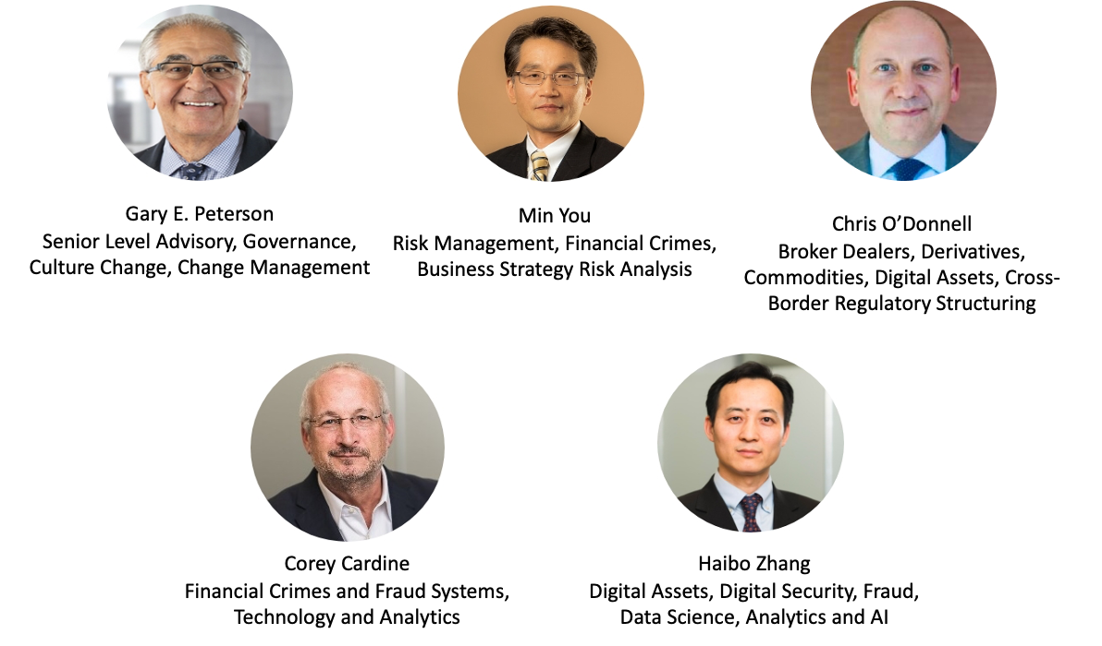
IMAG Senior Leadership Team
14

Slide 15
Thank You! www.imagny.com
Copyright 2026 IMAG

